Slide 1
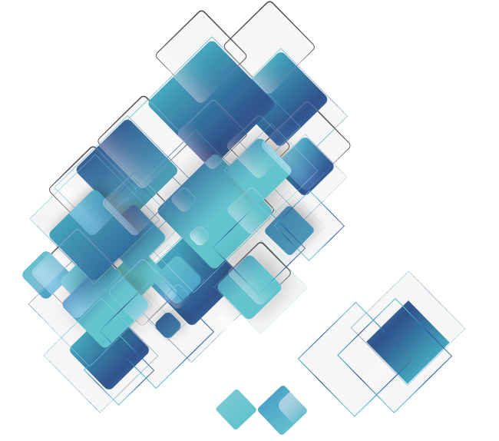
Facial Expression Recognition
Speaker: Liu Chengqi
Team Members: Liu Chengqi, Yang Junhao and Sun Zhenhuan

Slide 2

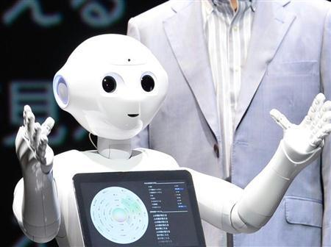
1. Reasons For Selecting the Topic
The need of human-computer communication in modern society.
Has a wide range of commercial applications.
A hot topic and there are a lot of research results.
Very interesting
[1] https://www.kaggle.com/mahmoudima/mma-facial-expression?select=MMAFEDB

Slide 3
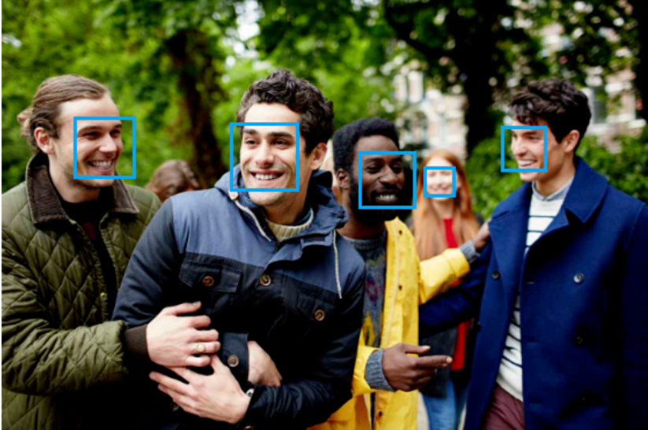
1. Reasons For Selecting the Topic
The need of human-computer communication in modern society.
Has a wide range of commercial applications.
A hot topic and there are a lot of research results.
Very interesting
[1] https://www.kaggle.com/mahmoudima/mma-facial-expression?select=MMAFEDB

Slide 4
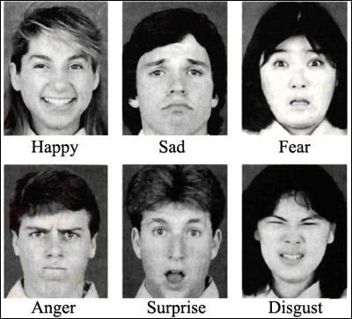
1. Reasons For Selecting the Topic
The need of human-computer communication in modern society.
Has a wide range of commercial applications.
A hot topic and there are a lot of research results.
Very interesting
[1] https://www.kaggle.com/mahmoudima/mma-facial-expression?select=MMAFEDB

Slide 5
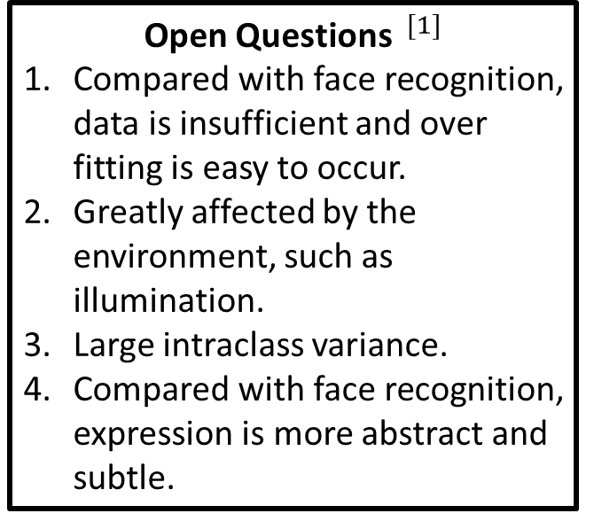
1. Reasons For Selecting the Topic
The need of human-computer communication in modern society.
Has a wide range of commercial applications.
A hot topic and there are a lot of research results.
Very interesting
Open Questions $^{[1]}$
Compared with face recognition, data is insufficient and over fitting is easy to occur.
Greatly affected by the environment, such as illumination.
Large intraclass variance.
Compared with face recognition, expression is more abstract and subtle.
[1] https://www.kaggle.com/mahmoudima/mma-facial-expression?select=MMAFEDB

Slide 6
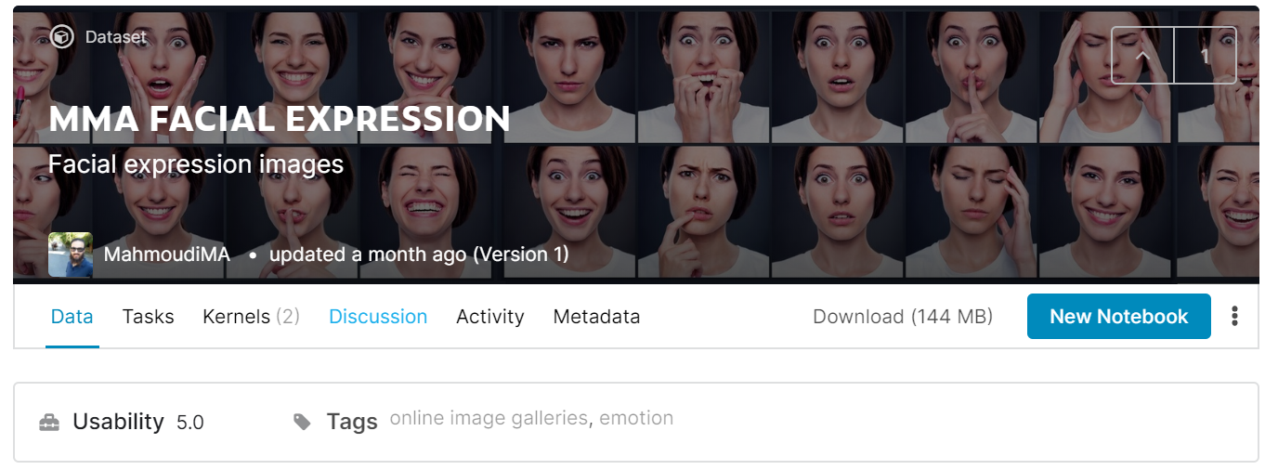
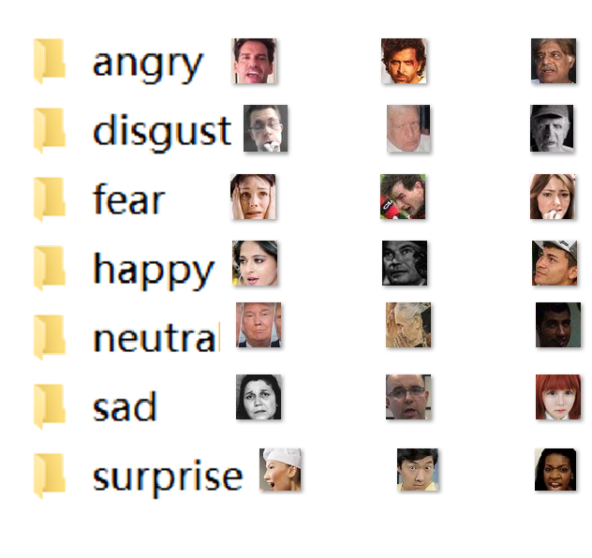
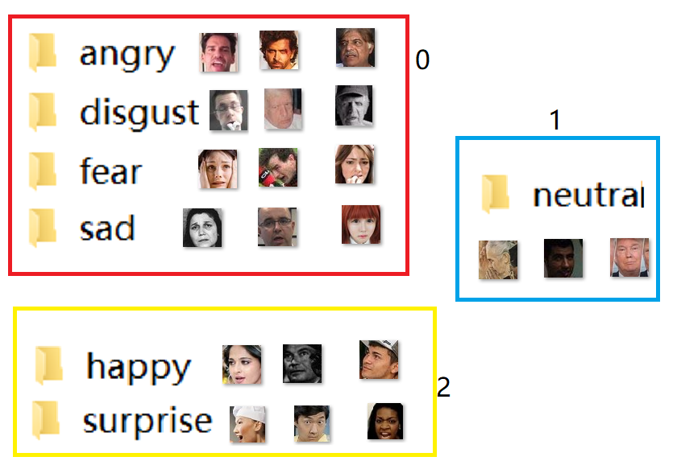
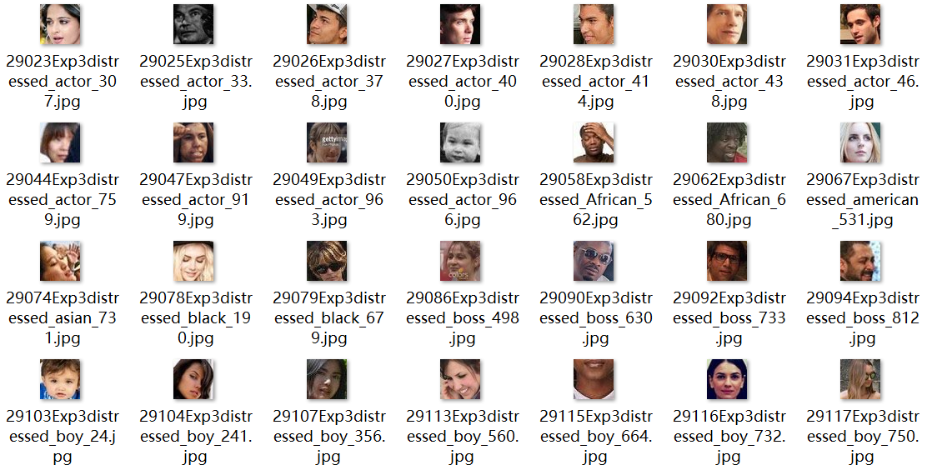

2. Data Collection
We found an up-to-date (June. 6) dataset of 128k face images from Kaggle $^{[2]}$.
These images are divided into 7 categories according to the basic expressions.
For simplicity, we rearrange them into three categories: positive, negative and neutral.
[2] https://www.kaggle.com/mahmoudima/mma-facial-expression?select=MMAFEDB

Slide 7
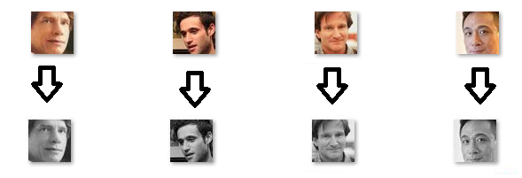

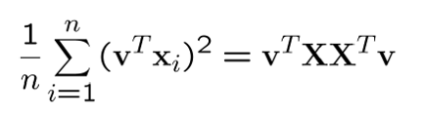
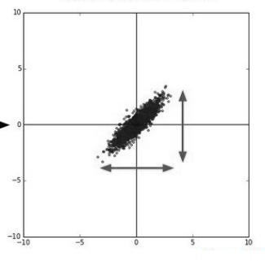
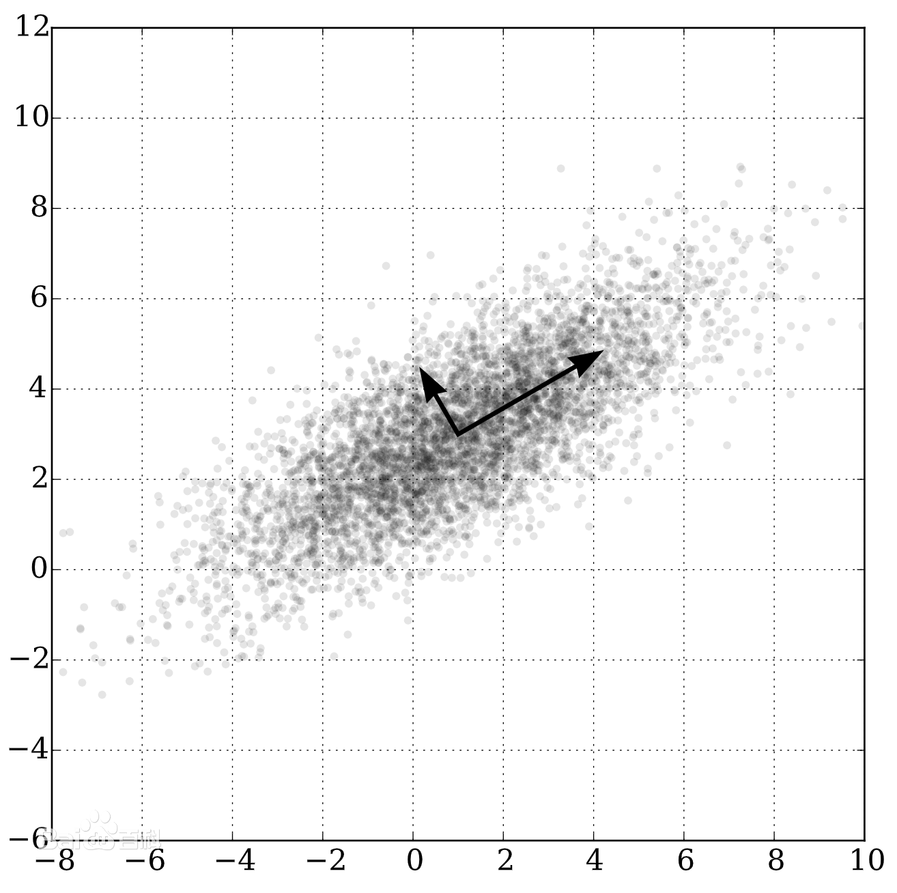
3. Data Preprocessing
Reclassification.
All images are converted to grayscale.
Standardization.
Principal Component Analysis (PCA) from 60*60 =3600 dimension to 20 dimension.

Slide 8
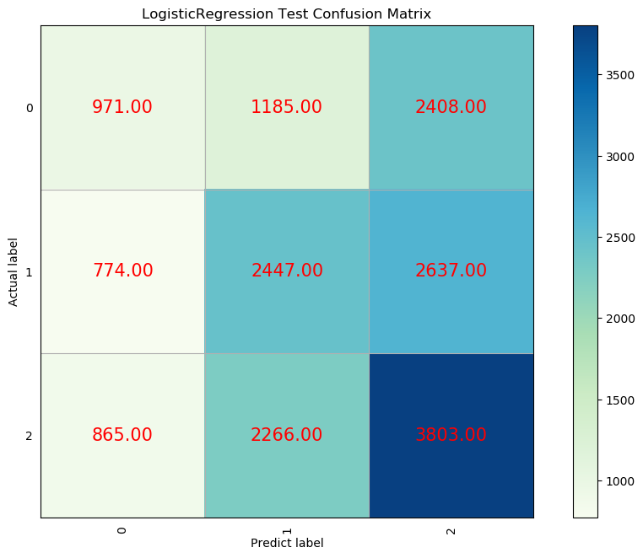
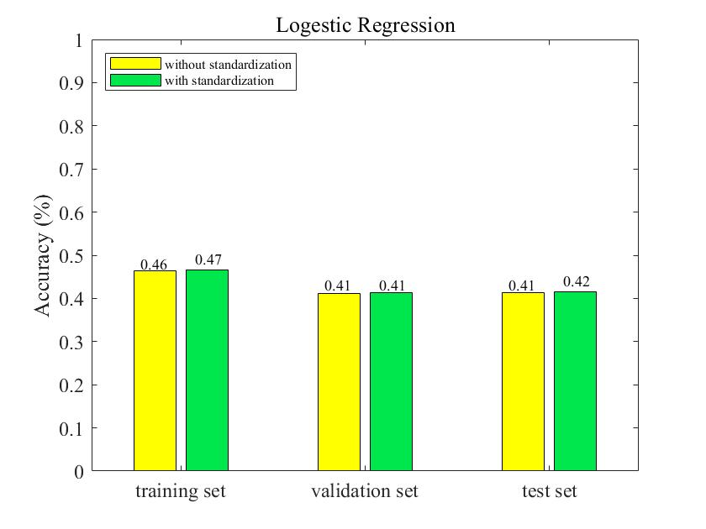
4. Logistic Regression (LR)
We first tried some simple models.
In the actual test, the classification effect is not very good.

Slide 9
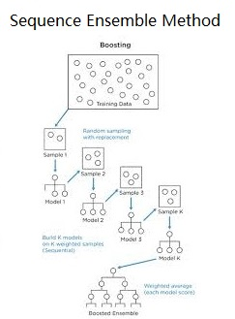
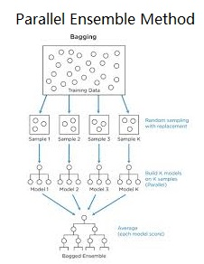
5. Ensemble Methods
Ensemble methods use multiple learning algorithms to obtain better predictive performance than could be obtained from any of the constituent learning algorithms alone.
Adaboost
Gradient Boost (GDBT)
Bagging
Random Forest (RF)

Slide 10
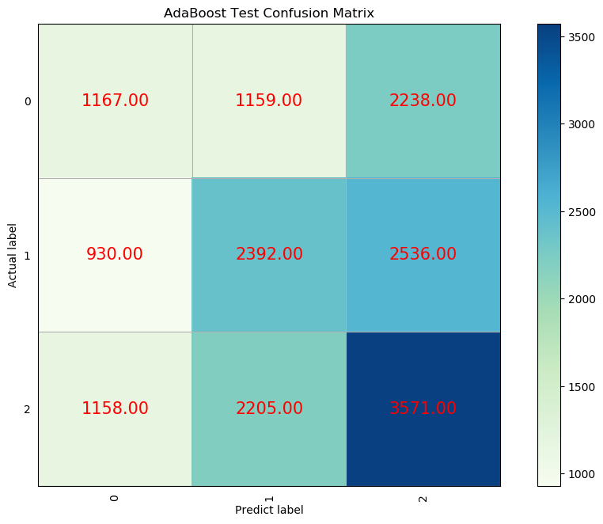
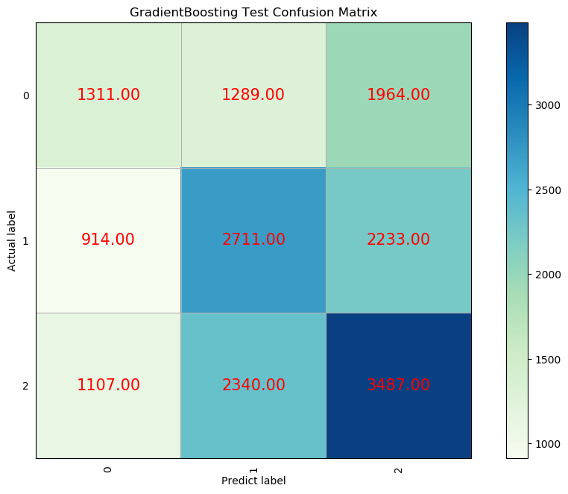
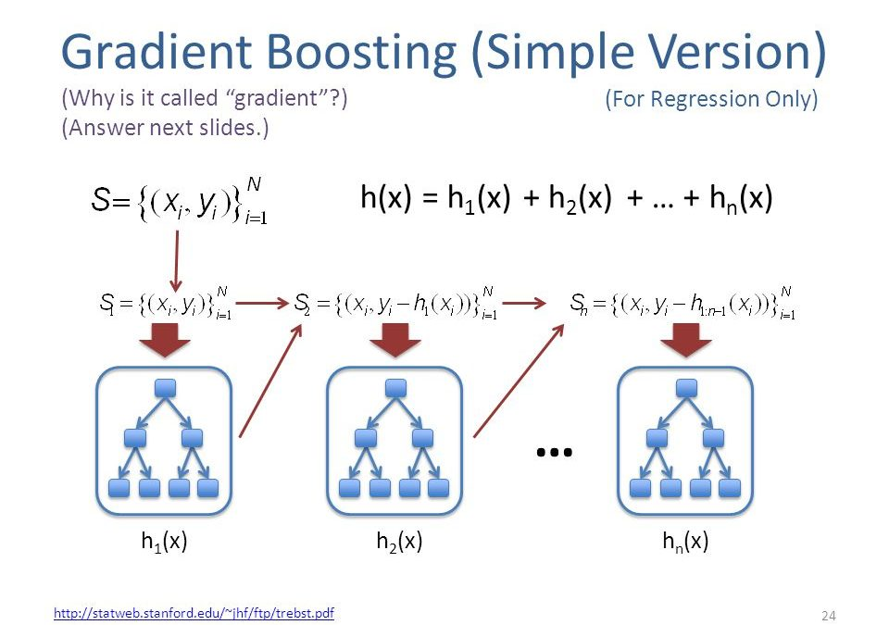
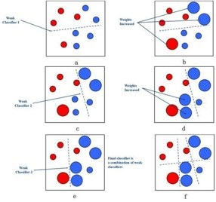
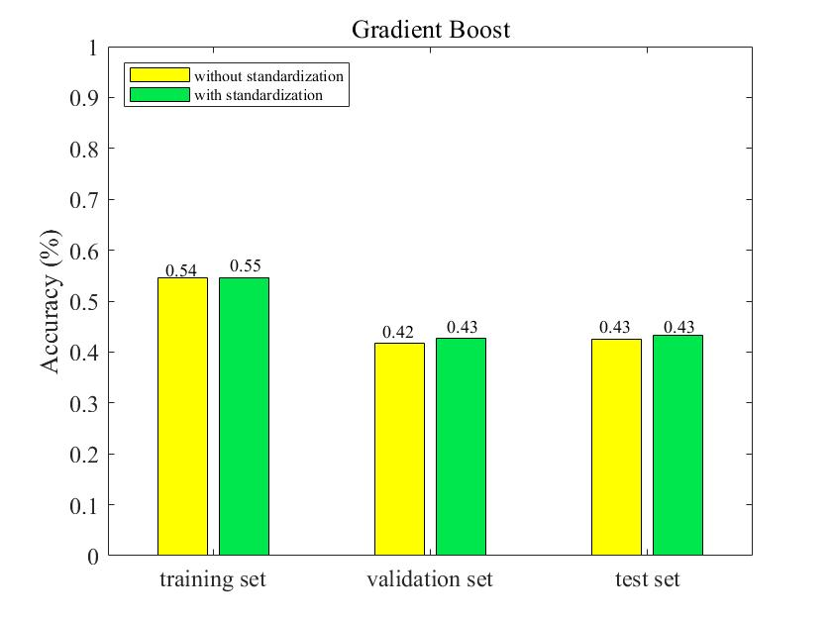
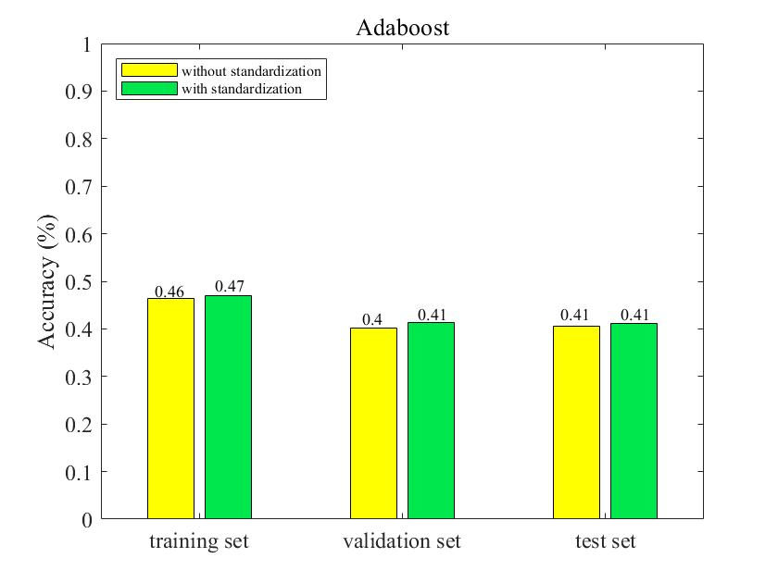
5.1 Sequence Ensemble Method
Adaboost
Gradient Boost (GDBT)

Slide 11
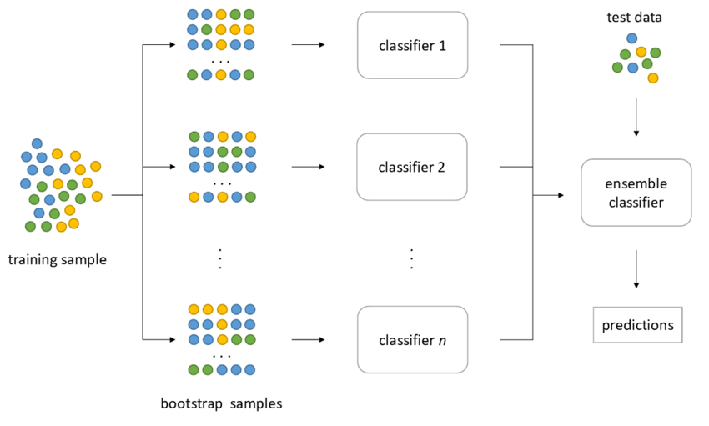
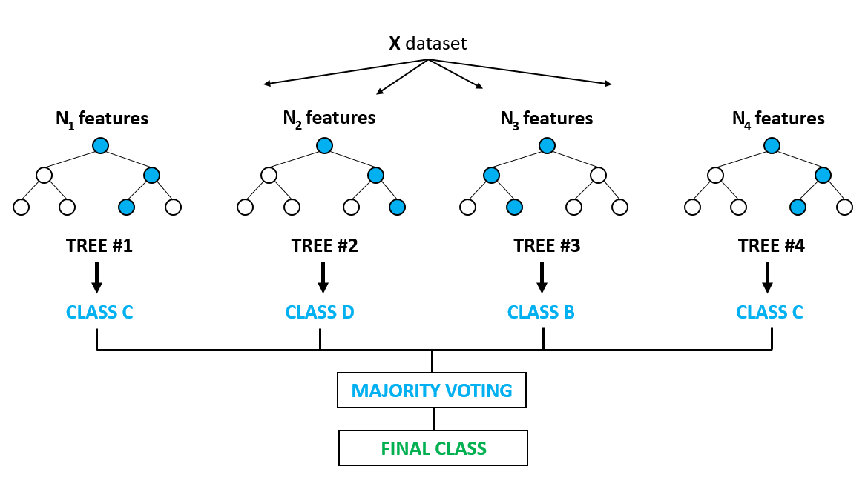
5.2 Parallel Ensemble Methods
Bagging
Random Forest (RF)

Slide 12
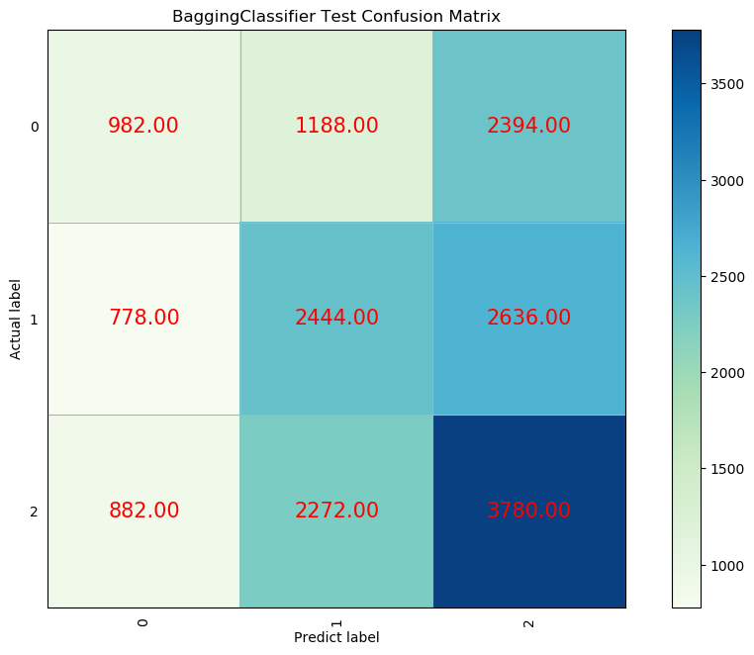
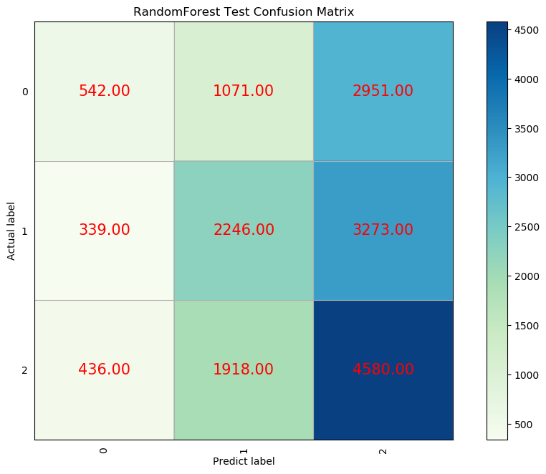
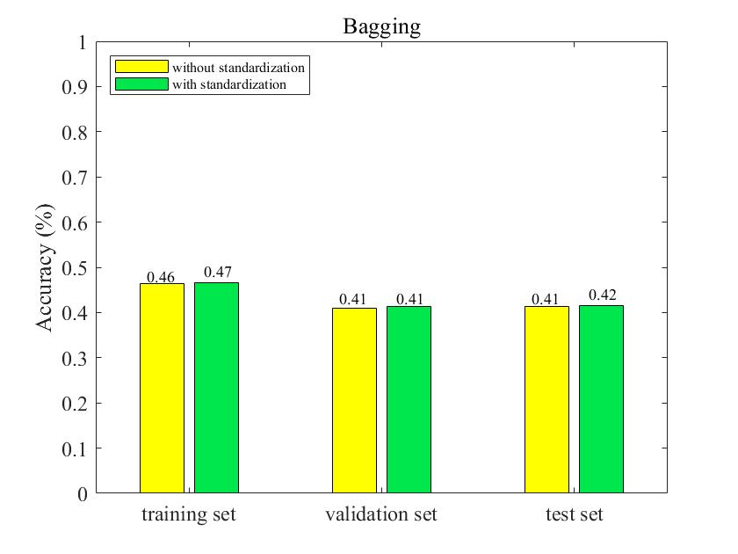
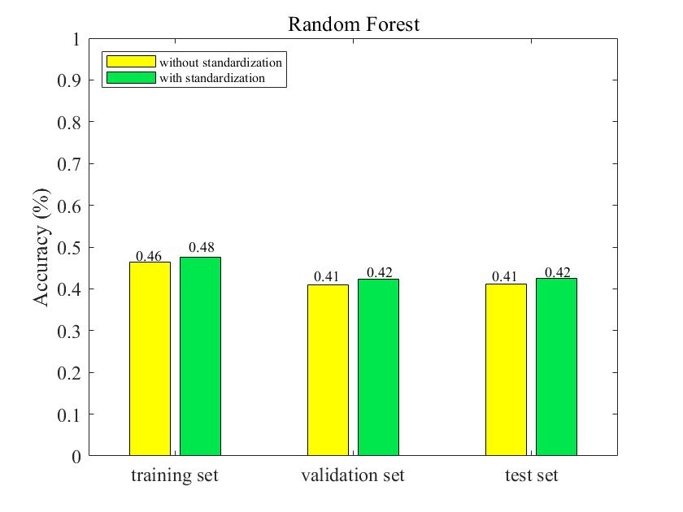
5.2 Parallel Ensemble Methods
Bagging
Random Forest (RF)

Slide 13
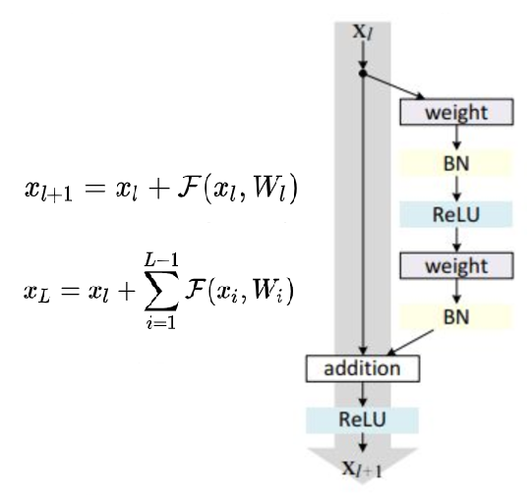
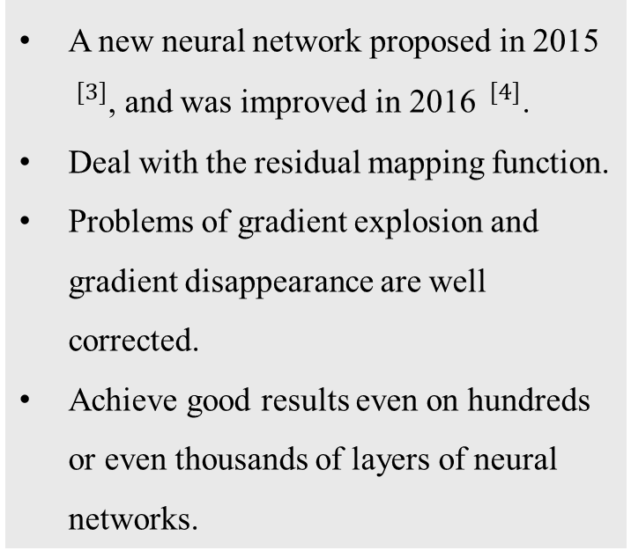
6. Residual Network (Resnet)
A new neural network proposed in 2015 $^{[3]}$, and was improved in 2016 $^{[4]}$.
Deal with the residual mapping function.
Problems of gradient explosion and gradient disappearance are well corrected.
Achieve good results even on hundreds or even thousands of layers of neural networks.
[3] https://arxiv.org/pdf/1512.03385.pdf
[4] https://arxiv.org/pdf/1603.05027.pdf

Slide 14
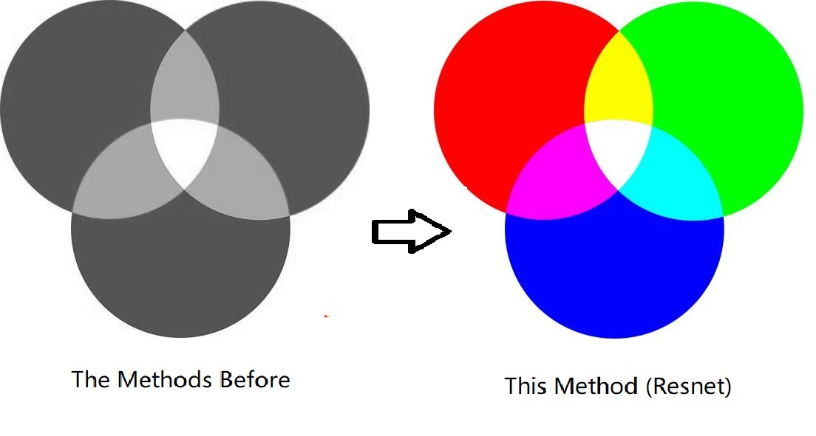
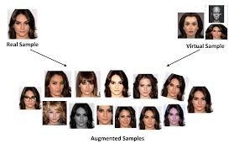
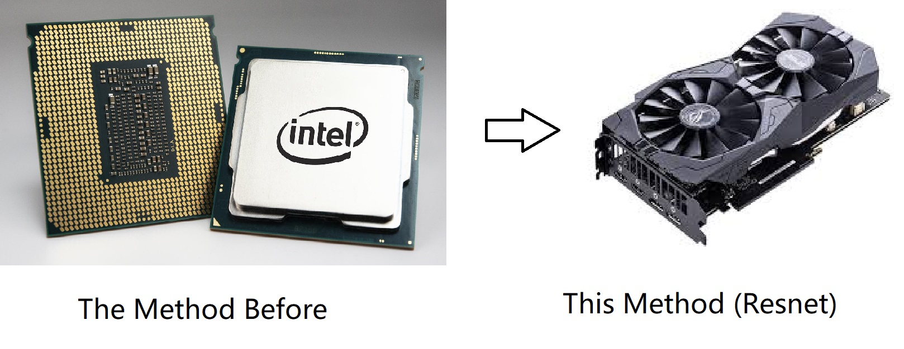
6. Residual Network (Resnet)
Further Preprocessing
Data standardization and PCA.
Use three colors RGB.
Use image data augmentation.
Check whether the computer has GPU, if so, use the GPU to process the image.

Slide 15
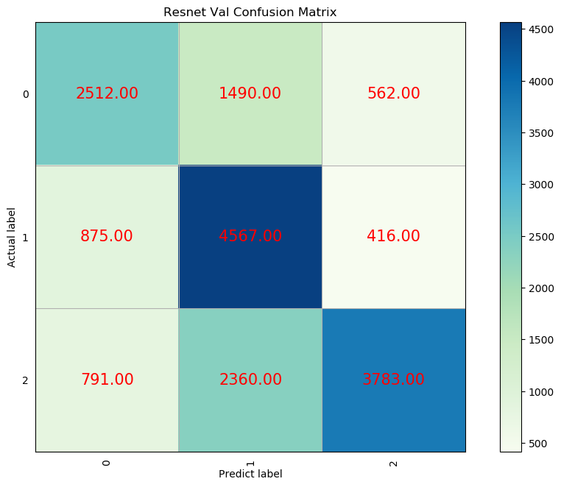
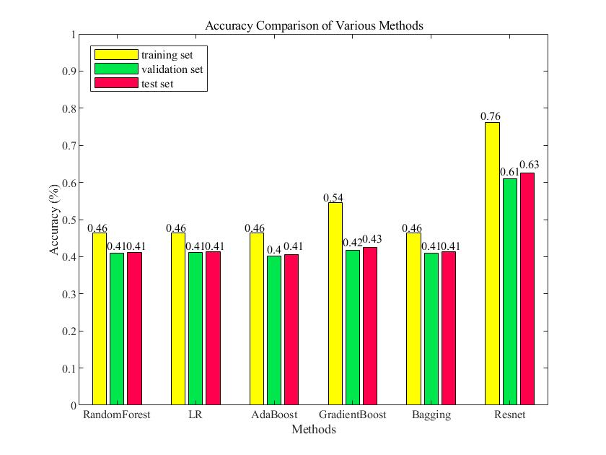
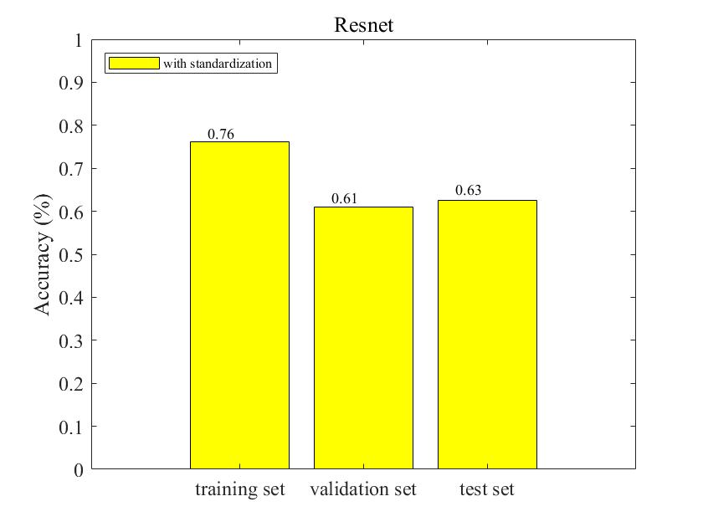
6. Residual Network (Resnet)
Epoch is 5
Learning rate is 0.001
Number of layers is 3
Freeze the model

Slide 16
7. Conclusion
Used five traditional methods in a new data set on Kaggle.
After summarizing the experience, we tried the Resnet method of deep learning then, and significantly improved the effect.

Slide 17
7. Conclusion
Reasons for Insufficient Accuracy
The picture is not clear enough.
The noise is large, affected by the environment.
The sample data is not balanced.

Slide 18
7. Conclusion
Direction of Improvement
Collect clearer images and shoot from multiple angles.
Processes the samples to the same size.
Increase the depth and complexity of neural network.

Slide 19
Thanks For Your Attention
Speaker: Liu Chengqi
Team Members: Liu Chengqi, Yang Junhao and Sun Zhenhuan

